Slide 1
Overestimating vs underestimating
Estimation and rounding

Slide 2
how to use Oak lessons

Slide 3
I can determine whether calculations using rounding or truncating will give an underestimate or overestimate.

Slide 4
An overestimate is an estimate for a calculation which is greater than the exact answer.
An underestimate is an estimate for a calculation which is less than the exact answer.

Slide 5

Overestimating vs underestimating
Estimating with multiplication and addition
Estimating with division and subtraction
Overestimating vs underestimating in context

Slide 6
Estimating with multiplication and addition
We round to help estimate an answer to a calculation. The answer is never exact and gives us a rough idea of the answer. As a result of rounding, the answer can sometimes be an overestimate or underestimate.

Slide 7
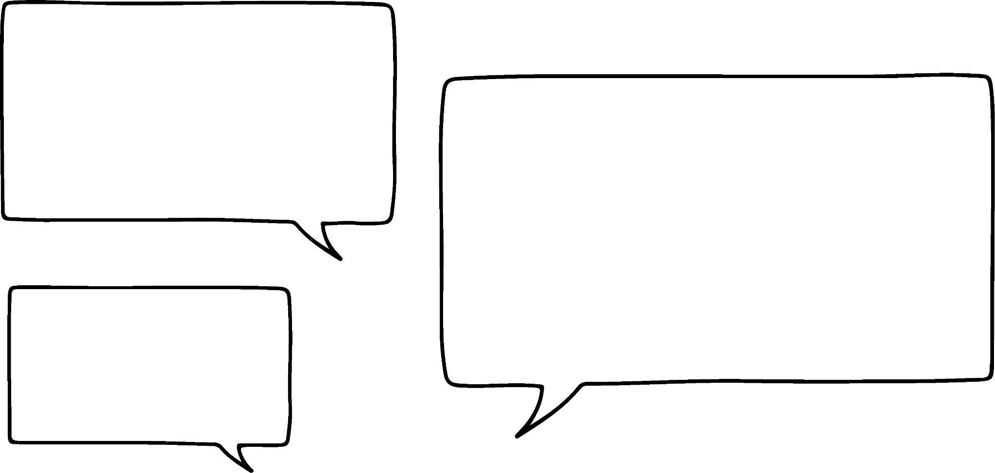
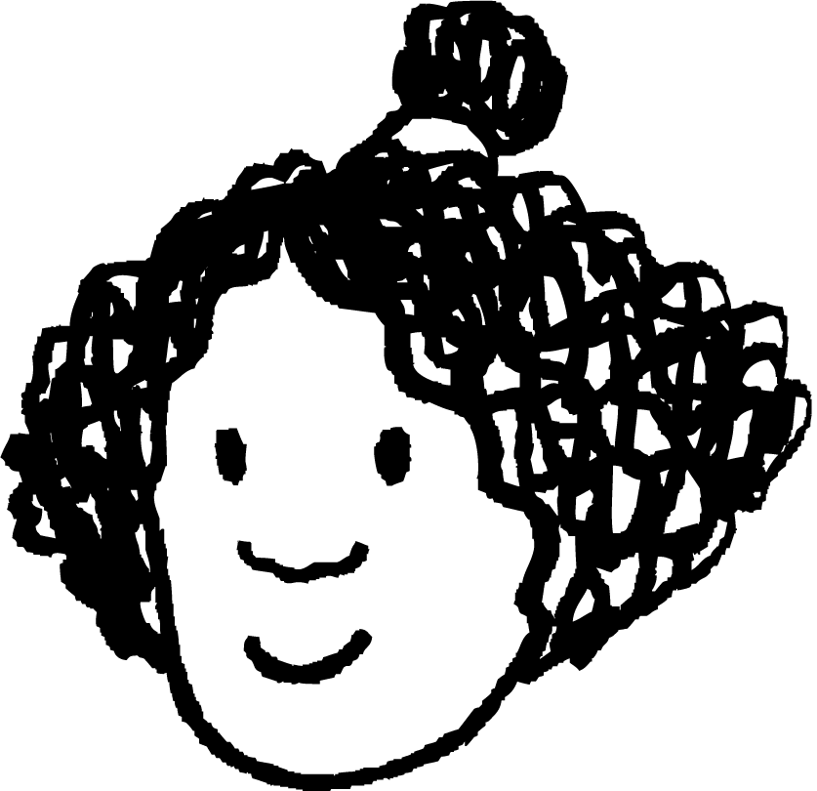
Estimating with multiplication and addition
Estimate the answer to 4.6 + 2.7
I would use 5 + 3
Izzy

Slide 8
Estimating with multiplication and addition
Estimated answer
Exact answer
4
4.6
5
Rounding the starting number up has made this increase from the exact value.
Rounding the addend up has made this increase from the exact value.
This is an overestimate.

Slide 9
Estimating with multiplication and addition
Without calculating the answers, which of the following will be an overestimate or underestimate?
158.953 + 236.12 ≈ 160 + 240
9.45 + 12.21 ≈ 9 + 12
When using addition, how are you able to identify if an estimate will be an overestimate or underestimate?
Overestimate
Underestimate
Rounding a value up + Rounding a value up = Overestimate
Rounding a value down + Rounding a value down = Underestimate

Slide 10

Estimating with multiplication and addition
Estimate the answer to 5.6 × 6.9
What calculation would you use to estimate this answer?
Lucas
5.6
6.9

Slide 11
Estimating with multiplication and addition
Estimate the answer to 5.6 × 6.9
Good! To something roughly like this.
I would use
6 × 7
Izzy
Lucas
5.6
6
6
6.9
6.9
7

Slide 12
Estimating with multiplication and addition
Estimate the answer to 5.6 × 6.9
So this was the original area model and here is your estimate.
Clearly 6 × 7 would give an overestimate as I have increased the area.
Izzy
Lucas
5.6
6
6.9
7

Slide 13
Estimating with multiplication and addition
1) Identify if the following gives an overestimate, underestimate or if it is hard to determine.
568.5445 + 453.56 ≈ 570 + 500
45.215 × 62.123 ≈ 50 × 60
5321 × 4236 ≈ 5000 × 4000
2455 + 2362 × 5466 ≈ 2500 + 2400 × 5500
0.565 + 0.461 × 0.31 ≈ 0.6 + 0.5 × 0.2
953 + 56.56 + 0.665 × 0.6 ≈ 1000 + 60 + 0.5 × 0.5
56.2² + 54.3² ≈ 60² + 50²

Slide 14
Estimating with multiplication and addition
2) Here is a calculation
8467 × 13.92 = 117 860.64
a) Write a multiplication that gives a product close to, but a little more than, 117 860.64
b) Write a multiplication that gives a product close to, but a little less than, 117 860.64

Slide 15
Estimating with multiplication and addition
1) Identify if the following gives an overestimate, underestimate or if it is hard to determine.
568.5445 + 453.56 ≈ 570 + 500
45.215 × 62.123 ≈ 50 × 60
5321 × 4236 ≈ 5000 × 4000
2455 + 2362 × 5466 ≈ 2500 + 2400 × 5500
0.565 + 0.461 × 0.31 ≈ 0.6 + 0.5 × 0.2
953 + 56.56 + 0.665 × 0.6 ≈ 1000 + 60 + 0.5 × 0.5
56.2² + 54.3² ≈ 60² + 50²
Overestimate
Hard to determine
Underestimate
Overestimate
Hard to determine
Overestimate
Hard to determine

Slide 16
Estimating with multiplication and addition
2) Here is a calculation
8467 × 13.92 = 117 860.64
a) Write a multiplication that gives a product close to, but a little more than, 117 860.64
b) Write a multiplication that gives a product close to, but a little less than, 117 860.64
Any values where the multiplier and/or multiplicand have been shifted upwards slightly. E.g. 8500 × 15
Any values where the multiplier and/or multiplicand have been shifted downwards slightly. E.g. 8400 × 10

Slide 17
Overestimating vs underestimating
Estimating with multiplication and addition
Estimating with division and subtraction
Overestimating vs underestimating in context

Slide 18
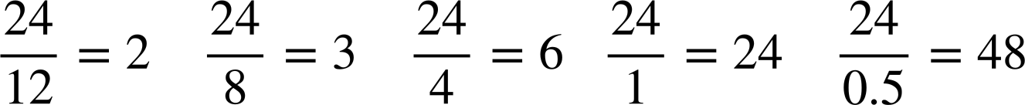

Estimating with division and subtraction
Here is a list of calculations. Work out the answers and put them in ascending order, smallest to largest.
As we make the divisor smaller, what do you notice about the answer to the calculation? Can you explain why?
As the divisor gets smaller, the answer gets bigger. This is because the divisor fits more times into the dividend.

Slide 19
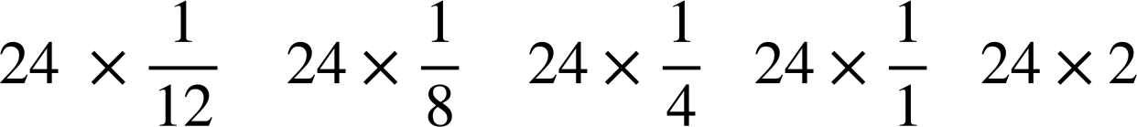
Estimating with division and subtraction
Here is a list of calculations. Work out the answers and put them in ascending order, smallest to largest.
Also, since division by a number is the same as multiplying by the reciprocal of that number, these are the equivalent calculations.

Slide 20
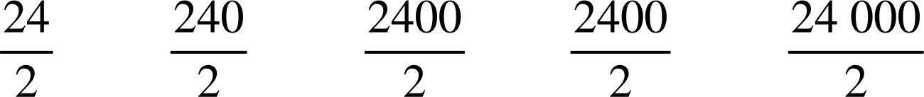
Estimating with division and subtraction
Let’s increase the dividend. What do you think happens to the answers as we increase the dividend?
As the dividend gets larger, the answer gets bigger. This is because we have more to share.

Slide 21

Estimating with division and subtraction
So when the dividend gets bigger, the answer gets bigger.
When the divisor gets bigger, the answer gets smaller?
Exactly.
Lucas
Jacob

Slide 22
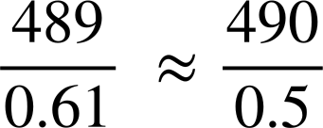
Estimating with division and subtraction
Do you think this is an overestimate or underestimate?
Lucas

Slide 23
Estimating with division and subtraction
The dividend of 489 is now bigger, so possibly an overestimate. The divisor of 0.61 has got smaller, so I am thinking overestimate.
Jacob

Slide 24

Estimating with division and subtraction
Which calculation shows an overestimate? Explain.
This calculation shows an overestimate.
Overall dividend has been rounded up. Expect an overestimate.
Overall dividend has been rounded down. Expect an underestimate.
The divisor has been rounded down. Expect an overestimate.
The divisor has been rounded up. Expect an underestimate.

Slide 25
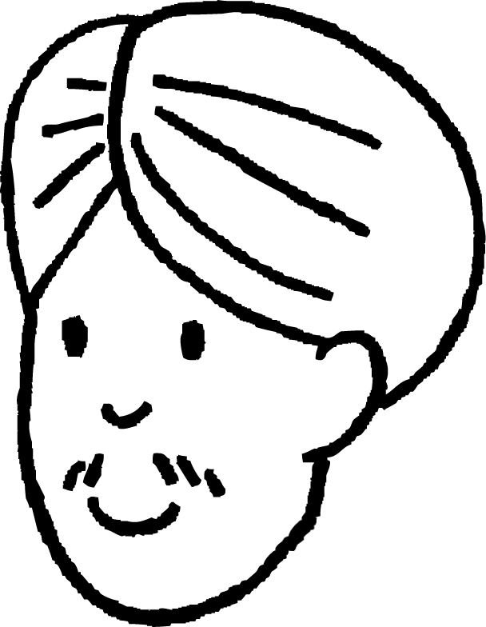
Estimating with division and subtraction
Let me guess, when we round the dividend up and round the divisor up or vice versa, it is difficult to tell if it is an overestimate or underestimate.
You are right again Andeep!
Lucas
Andeep
Do you think you can explain why?
As a result of rounding or truncating, it is unclear how much the difference is between the overestimate and underestimate of a divisor or dividend will be.

Slide 26

Estimating with division and subtraction
Put a tick if the the statement is true.
Rounded up gives an overestimate Rounded down
Rounded down gives an underestimate
Rounded up
Rounded down is hard to tell
Rounded down
Rounded up is hard to tell
Rounded up

Slide 27
Estimating with division and subtraction
Estimate the answer to 23.6 − 5.8
What calculation would you use to estimate the answer?
I would round up 23.6 to 25 and round down 5.8 to 5 so 25 − 5
Izzy
Lucas

Slide 28
Estimating with division and subtraction
Estimated answer
Exact answer
5.8
5
Exact answer
20
23.6
25
Estimated answer
(overestimate)

Slide 29
Estimating with division and subtraction
Using number lines, investigate if you get an overestimate, underestimate or hard to tell when subtracting and rounding up or down. You can use number lines to help. Fill in the table.
Subtraction | Overestimate | Underestimate | Hard to tell
Rounded up − Rounded down
Rounded up − Rounded up
Rounded down − Rounded up
Rounded down − Rounded down

Slide 30
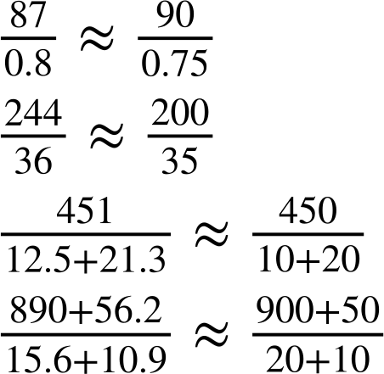


Estimating with division and subtraction
Identify if the estimate calculations will give an overestimate, underestimate or is hard to tell.
a)
b)
c)
d)
overestimate
overestimate
underestimate
hard to tell

Slide 31
Estimating with division and subtraction
1a) Without calculating,
15.99 ÷ 4
is this a little more than 4, a little less than 4 or exactly 4?
b) Without calculating,
16 ÷ 3.99
is this a little more than 4, a little less than 4 or exactly 4?

Slide 32
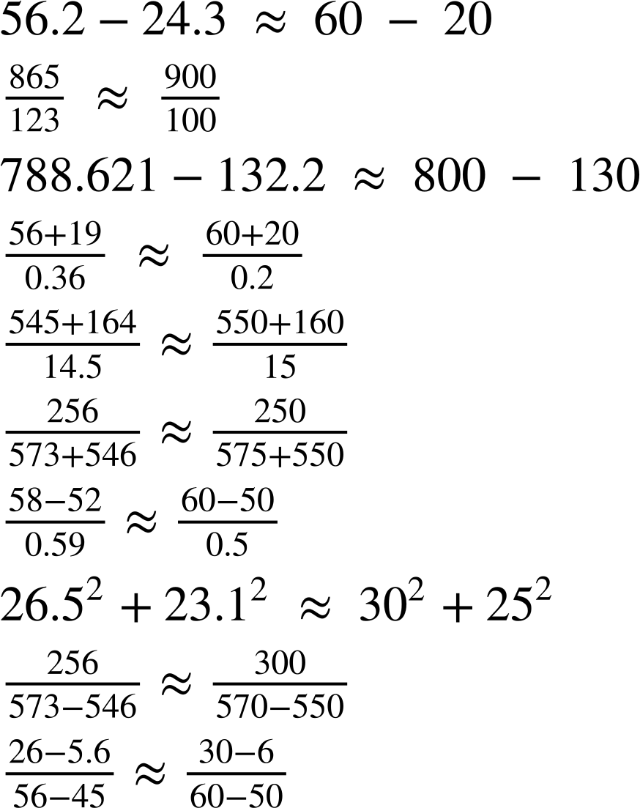
Estimating with division and subtraction
2) Identify if the following gives an overestimate, underestimate or if it is hard to determine.
a)
b)
c)
d)
e)

Slide 33
Estimating with division and subtraction
2) Identify if the following gives an overestimate, underestimate or if it is hard to determine.
f)
g)
h)
i)
j)

Slide 34
Estimating with division and subtraction
1a) Without calculating,
15.99 ÷ 4
is this a little more than 4, a little less than 4 or exactly 4?
b) Without calculating,
16 ÷ 3.99
is this a little more than 4, a little less than 4 or exactly 4?
A little less than 4
A little more than 4

Slide 35
Estimating with division and subtraction
2) Identify if the following gives an overestimate, underestimate or if it is hard to determine.
a)
Overestimate
b)
Overestimate
Overestimate
c)
d)
Overestimate
e)
Underestimate

Slide 36
Estimating with division and subtraction
2) Identify if the following gives an overestimate, underestimate or if it is hard to determine.
f)
Underestimate
g)
Overestimate
h)
Overestimate
i)
Overestimate
j)
Hard to tell

Slide 37
Overestimating vs underestimating
Estimating with multiplication and addition
Estimating with division and subtraction
Overestimating vs underestimating in context

Slide 38
Overestimating vs underestimating in context
The operation and the rounding play an important part when identifying if a number will be an overestimate or underestimate.
Overestimating and underestimating have a practical role in real life.

Slide 39
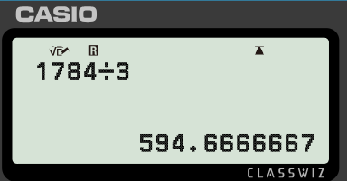
Overestimating vs underestimating in context
Three friends are going on holiday. The total cost of the holiday is £1784, which they are going to share equally.
Aisha uses a calculator to work out 1784 ÷ 3
She thinks of six different ways to tell her friends how much they will each pay.
●about £600 ●about £1000 ●about £590
●about £594 ●about £595 ●about £594.66
Choose and justify which estimate would be most appropriate in this scenario.

Slide 40
Overestimating vs underestimating in context
Three friends are going on holiday. The total cost of the holiday is £1784, which they are going to share equally.
Aisha uses a calculator to work out 1784 ÷ 3
She thinks of six different ways to tell her friends how much they will each pay.
●about £600 ●about £1000 ●about £590
●about £594 ●about £595 ●about £594.66
£595 might be is best as it doesn’t involve dealing with small coins and doesn’t end up short of the total. Given money is always dealt with to two decimal places, £594.66 should be rounded to 594.67. Using £594.66 leaves them 2 p short.

Slide 41
Overestimating vs underestimating in context
Lift A
Lift B
The two signs on the left are from different lifts. Each lift can carry a different number of people.
Which lift assumes that people are heavier?
Which lift is easier to estimate? Why?
🠋 G
▲ 4
Max load
8 persons or 630 kg
Capacity 1000 kg
13 persons
c) Nine identical boxes are under the weight limit for one lift, but over it for the other lift. What do you know about the weight of the boxes?
d) Five boxes weighing 23 kg each are put into each lift. Approximately how many people can safely get in the lifts with them?
e) Explain why it is better to overestimate all the scenarios above.

Slide 42
Overestimating vs underestimating in context
Lift A
Lift B
The two signs on the left are from different lifts. Each lift can carry a different number of people.
Which lift assumes that people are heavier?
🠋 G
▲ 4
Max load
8 persons or 630 kg
Capacity 1000 kg
13 persons
Lift A assumes people are heavier. A likely estimation might be 640 ÷ 8 = 80 kg for Lift A and 1040 ÷ 13 = 80 kg Lift B. As these give the same answer, the actual weight is closer to 80 for the first lift than it is for the second. The actual assumed weights are 78.75 kg and 76.92 kg (to 2 d.p.) respectively.

Slide 43
Overestimating vs underestimating in context
Lift A
Lift B
The two signs on the left are from different lifts. Each lift can carry a different number of people.
b) Which lift is easier to estimate? Why?
🠋 G
▲ 4
Max load
8 persons or 630 kg
Capacity 1000 kg
13 persons
Answers can vary. Some may argue that the first lift is easiest, as 630 is close to 640, which is a multiple of 8, so 640 ÷ 80 is a straightforward calculation. You may find the second lift easier may also use the strategy of finding a ‘nearby’ multiplication fact such as 960 ÷ 12 or 1040 ÷ 13

Slide 44
Overestimating vs underestimating in context
Lift A
Lift B
The two signs on the left are from different lifts. Each lift can carry a different number of people.
c) Nine identical boxes are under the weight limit for one lift, but over it for the other lift. What do you know about the weight of the boxes?
🠋 G
▲ 4
Max load
8 persons or 630 kg
Capacity 1000 kg
13 persons
The boxes must weigh between 70 kg and approximately 111 kg.

Slide 45
Overestimating vs underestimating in context
Lift A
Lift B
The two signs on the left are from different lifts. Each lift can carry a different number of people.
d) Five boxes weighing 23 kg each are put into each lift. Approximately how many people can safely get in the lifts with them?
🠋 G
▲ 4
Max load
8 persons or 630 kg
Capacity 1000 kg
13 persons
Answers will depend on how to estimate or calculate with 23. You might take the total weight of the boxes to be 100 (rounding 23 to 20), 115 (using 23) or 125 (rounding 23 to 25). Approximately six people can get into the first lift with the boxes; approximately 11 people can get into the second lift with the boxes.

Slide 46
Overestimating vs underestimating in context
Lift A
Lift B
The two signs on the left are from different lifts. Each lift can carry a different number of people.
e) Explain why it is better to overestimate all the scenarios above.
🠋 G
▲ 4
Max load
8 persons or 630 kg
Capacity 1000 kg
13 persons
For estimating weight in a lift, it is better to overestimate. If we underestimate, then the lift is in danger of exceeding capacity and breaking.

Slide 47
Overestimating vs underestimating
We round to help estimate an answer to a calculation. The answer is never exact and gives us a rough idea of the answer. As a result of rounding, the answer can sometimes be an overestimate, underestimate or it is hard to tell.
The operations we use and the type or rounding e.g. rounding up, rounding down or truncating will also play an important role in an overestimate or underestimate.

Slide 48

© Oak National Academy 2024.
Produced in partnership with Mathematics in Education and Industry.
Licensed on the Open Government Licence v3.0, except where otherwise stated. See Oak terms and conditions.

